Slide 1
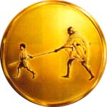
Value Added Course
MGM BLS
Mahatma Gandhi Mission
MGM
SKILLS LAB

Slide 2




AMERICAN COLLEGE OF SURGEONS AND ATLS(I) ACCREDIATED ATLS & ATCN

Slide 3
INFANT CHOKING

Slide 4
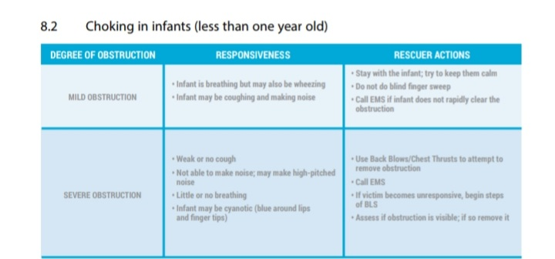

Slide 5
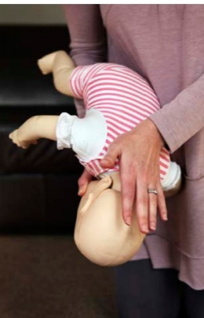
Back blows and chest thrusts in infants
In a choking but responsive infant less than one year old, back blows and chest thrusts are used instead of the Heimlich maneuver.
1. Hold the child in your lap.
2. Put the infant with their face down and their head lower than their chest; they should be resting on your forearm. Put your forearm on your thigh

Slide 6
Support the child’s head and neck with your hand and be sure to avoid putting pressure on their throat.
4. Using the heel of your free hand, deliver five back blows between the child’s shoulder blades.
Using both hands and arms turn the child face up So that now they are resting on your other arms This arm should now be resting on your thigh
Make sure the childs head is lower than its chest
Using fingers of your Free hand provid five quick Downward chest thumps over lower half of breast bone Perform one thrust every second (Fig 2)
If the obstruction is not relieved turn the infant face down and repeat the same process
Continue these steps until infant begins to breathe

Slide 7
